Slide 1

SharpView: Improved Legibility of Defocused Content on Optical See-Through HMDs
1451023: Kohei Oshima
Interactive Media Design Lab
Nara Institute of Science and Technology
2015.04.06 : Kohei Oshima
Notes:
Good afternoon everyone. I’m Kohei Oshima, M2 student.
Today I’ll introduce my research contents and talk about my progress.
My research title is 『Sharp View: Improved Legibility of Defocused Content on Optical See-Through HMDs』

Slide 2

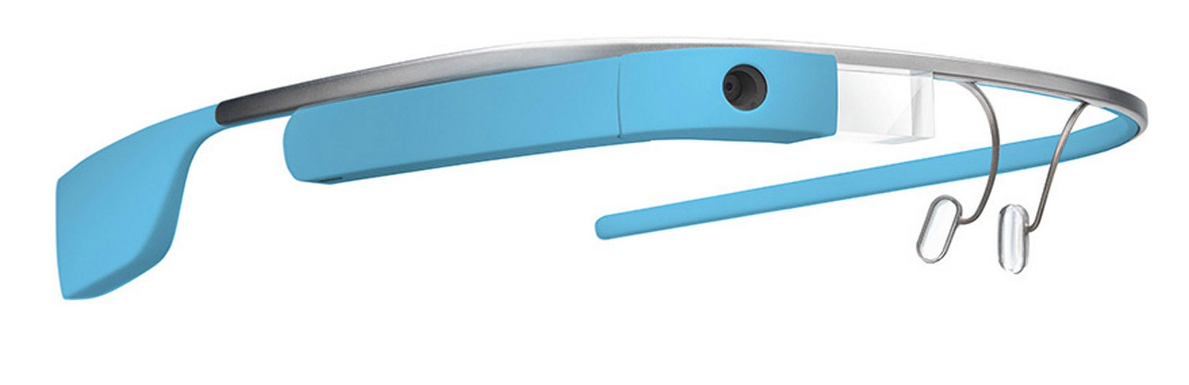
Optical See-Through HMDs
Optical See-Through HMDs attract attention as an Augmented Reality device
We can see real scene and CG at the same time
Google Glass
Map application
2015.04.06 : Kohei Oshima
Notes:
Now Optical See-Through Head Mounted Displays attract attention as an Augmented Reality device.
It is a wearable, and transparent display. We can see real scene and CG at the same time.
This is Google Glass. It’s a kind of Optical See-Through HMDs. This is a useful and practical device.
For instance, by wearing a Google Glass, we can check the map while cycling like this.

Slide 3
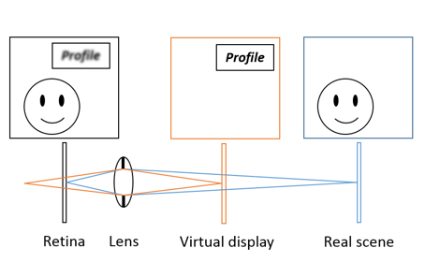
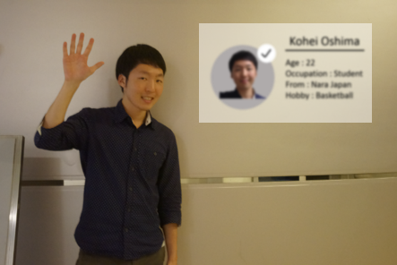
Purpose
Reducing a focus blur effect on Optical See-Through HMDs
Focus blur occurs because the depth of Virtual display and Real scene are different
It is necessary to adjust the focus when viewing the virtual display
Schematic optics
Conventional method
2015.04.06 : Kohei Oshima
Notes:
But Optical See-Through HMD has Focus blur problem because the depth of Virtual display and Real scene are different. Please look at this figure, it represents what is the optical system of the Optical See-Through HMD viewed from above.
This is eye lens, and retina, HMD’s virtual display, and real scene. If we look at real scene, the CG on the virtual display looks blurry like this.
Now on the virtual display, conversation partner’s profile is displayed. When you shift gaze to virtual display, you have to adjust the focus. It’s very annoying. So we’d like to reduce this focus blur effect.

Slide 4
Related Work
Light Field Display
By controlling the light ray, Light Field Display can present the image as if it exists actually
Tailored Displays(Pamplona et al.2012)
Problem:
Big computational time
Special display
Computational AR Eyeglasses(Maimone et al.2013)
2015.04.06 : Kohei Oshima
Notes:
Of course there are related works.
I think Light Field Display can solve this problem.
By controlling the light ray, light field display can present the image as if it exists actually.
These are examples of the light field display research.
But there are some limitations. It needs high computational time and special display.
We aim to solve it by only image processing to reduce calculations and apply for conventional display.

Slide 5
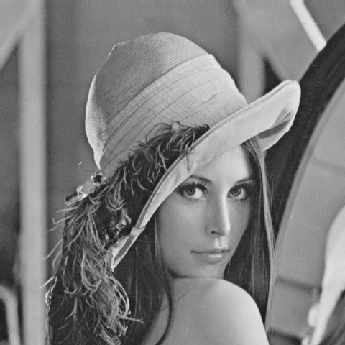
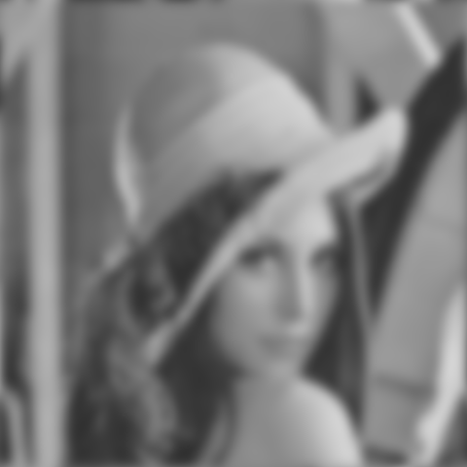
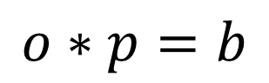



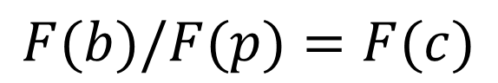
Approach
Applying a focus blur correction technique
Focus blur is represented
by convolution
※p : Point Spread Function
(Blur function)
Original(o)
Blur(b)
Focus blur is corrected by Fourier transform
Blur(b)
Correction(c)
2015.04.06 : Kohei Oshima
Notes:
As an approach, we will apply the focus blur correction technique.
Focus blur is represented by convolution like this equation. ”o” is original image and “b” is blur image.
“p” means point spread function, it is blur function.
And it is corrected by Fourier transform because convolution is expressed as multiple in Fourier domain.
Correct image, c is calculated by this equation.
Maybe you can confirm that corrected image has better visibility than blur one.
We will apply this focus blur correction technique.

Slide 6
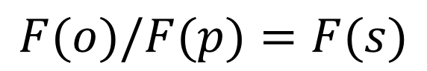
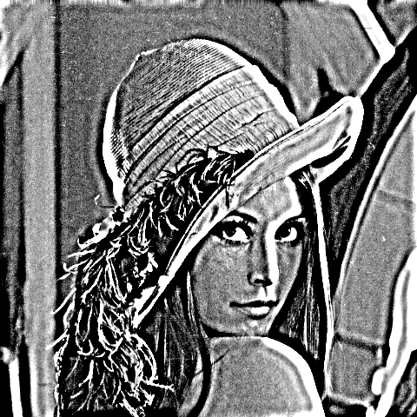

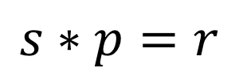
Method
Displaying the image that has been divided according to the Point Spread Function(PSF) of the lens
Sharpened image is restored by using focus blur
Sharpened(s)
Restored(r)
We need to get Point Spread Function(PSF) of the eyes
2015.04.06 : Kohei Oshima
Notes:
Our method is to display the image that has been divided according to the Point Spread Function of the lens.
We can make sharpened image by this equation. And this image will be restored by using focus blur.
In the case of Optical See-Through HMDs, by displaying the sharpened image according to eye’s psf, we can reduce focus blur effect.
For that, we need to get eye’s PSF.

Slide 7
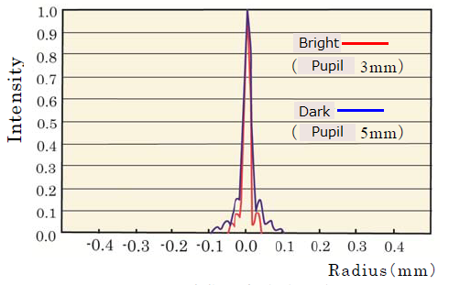
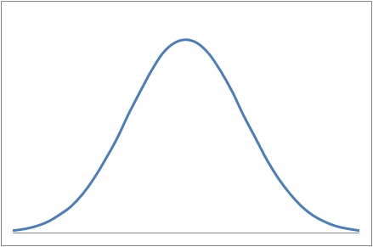
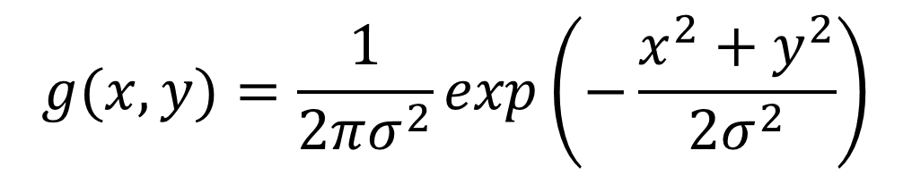
Eye’s PSF
We approximate eye’s PSF as a Gaussian function
Eye’s PSF is expressed by the following equation
*Several papers treated eye’s PSF as a Gaussian function
*Takayuki Okatani, Takashi Ishizawa, Koichiro Deguchi: “Gaze-Reactive Image Display for Enhancing Depth Perception by Depth-of-Field Blur“, 電子情報通信学会論文誌, 2009
Example of eye’s PSF
σ
2015.04.06 : Kohei Oshima
Gaussian function
Notes:
To get eye’s PSF, we approximate eye’s PSF as a Gaussian function, because eye’s psf has very similar shape to Gaussian function like this. This is an example of eye’s psf. In fact, Several Papers treated eye’s PSF as a Gaussian function.
So eye’s PSF is expressed by the following equation, it depends on only one variable sigma.
To get eye’s PSF, we must determine this parameter sigma.

Slide 8
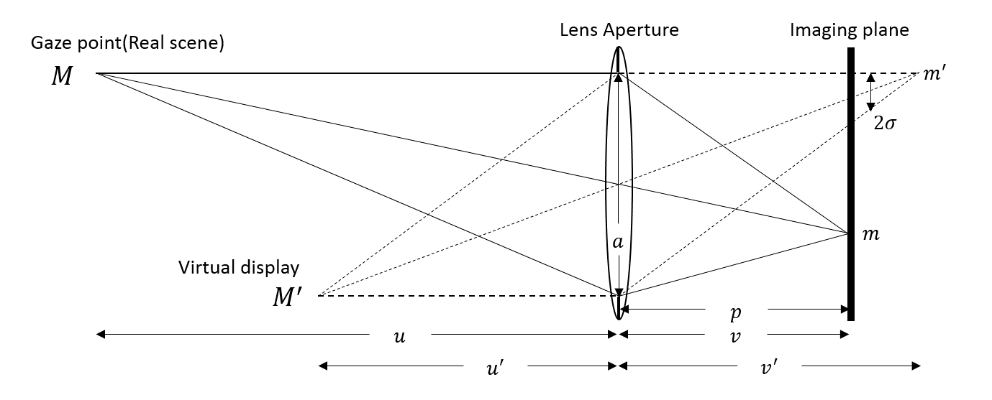
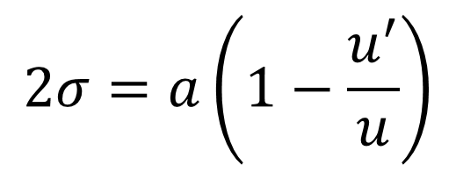
How to Calculate Sigma
We consider the human eye as a lens camera model
α (lens aperture) u (distance between the lens and real scene) u’ (distance between the lens and virtual display)
Sigma is calculated from
2015.04.06 : Kohei Oshima
Notes:
To determine sigma, we consider human eye as simple lens camera model. Please look at this figure, it shows the optical system when using an Optical See-Through HMD. This is eye lens, and this is image plane, retina. Now lens focus on this point M “real scene”. When that, this point M’ “virtual display” is blurred, and blur radius equals to sigma.
The radius of blur is calculated from this equation. “a” means lens aperture, and “u” means distance between lens and real scene, and “u’” means distance between lens and virtual display. We can obtain this equation by the lens equation and the triangle ratio. I’d like to confirm this equation is true or not.

Slide 9
Psychophysics Exp
To confirm our logic is true or not
・We fix these 3 parameters
α: Pupil size
Light environment is unchanged Pupil diameter is measured by eye tribe and using the distance between eyes as a cue
u: Distance between eyes and gaze point
Subject’s head position is fixed by chin-rest
Subjects are indicated to focus on white board
u’: Distance between eyes and virtual display
The distance is stable
We determined it as arm’s length(70 cm)
Experimental environment
2015.04.06 : Kohei Oshima
Notes:
From now, I’ll talk about my progress. I performed Psychophysics experiment.
I’ll explain about setup. First I have to get 3 parameters.
About “a”, this is pupil size. I fixed light environment because pupil size also depends on the light brightness.
If it’s bright, pupil diameter will be smaller, and if it’s dark, pupil diameter will be larger.
Pupil diameter is measured every time by gaze tracker, eye tribe and using the distance between eyes as a cue.
This device has infrared camera, we can calculate pupil diameter from this image.
About “u”, this is a distance between eyes and gaze point.
Subject’s head position is fixed by this chin-rest.
And they are indicated to focus on the target on white board during tasks. There is a character “A” as a target.
By doing this, I can know the distance “u” and fix it.
About “u’”, this is a distance between eyes and virtual display.
In the case of HMD, “u’” is stable because the display position is unchanged.
And we determined it as arm’s length by pilot test.

Slide 10
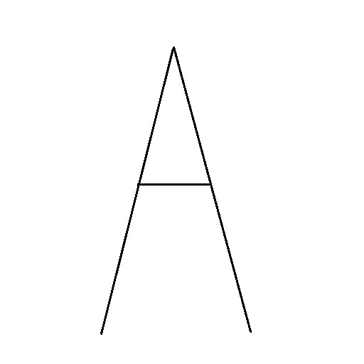




Experiment Settings
Participants: 8 subjects
Images: Character “A” and Lena
Task: Comparison 2 images
・There are 7 degrees of sharpening
between -0.9 and +0.9 in 0.3 intervals
Character “A”
Lena
・1.0 means the sharpening image
according to measured parameters
0.1(σ=0.5)
1.0(σ=5.0)
1.9(σ=9.5)
・Subjects are given 2 images from 7 sharpening degrees
・Subjects should select which image has better visibility
・Subjects compare 168(6*7*2*2) times
2015.04.06 : Kohei Oshima
User perspective
Notes:
Next I’ll talk about experiment settings.
About Participants, we collected 8 subjects. They don’t wear glasses and contact lens. They have normal vision.
About images, we used these 2 images for experiment.
As a kind of simple image, Character “A” and complicated image, Lena.
There are 7 degrees of sharpening between -0.9 and +0.9 in 0.3 intervals respectively.
For instance, when we set the sharpening image according to Gaussian function (σ=5.0) as 1.0,
-0.9(0.1) means he sharpening image according σ=0.5, and +0.9(1.9) means he sharpening image according σ=9.5.
Of course, there are other 4 images, 0.4, 0.7, 1.3, 1.7.
In this case, the sharpening image 1.0 means “SharpView” calculated from measured parameters.
Experiment task is a comparison of 2 images.
Subjects are given 2 images from 7 sharpening degrees randomly.
And then, they should select which image has better visibility. This is user perspective.
They can switch 2 images by keyboard.
Totally they compared 168 times because there are 7 images, the permutation is 7 times 6.
And they repeated it 2 times respectively.

Slide 11
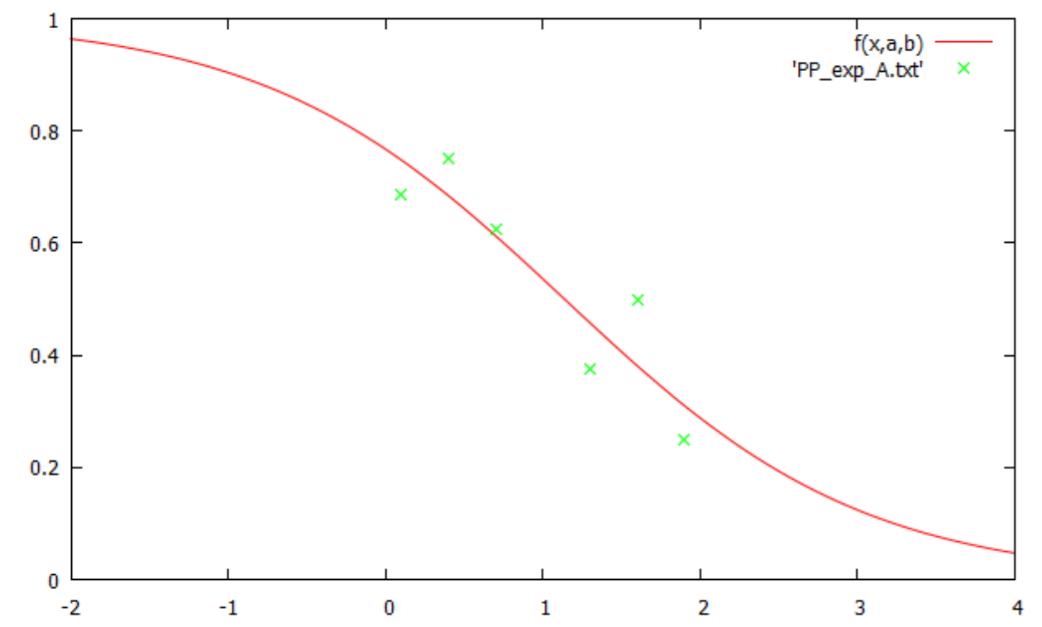
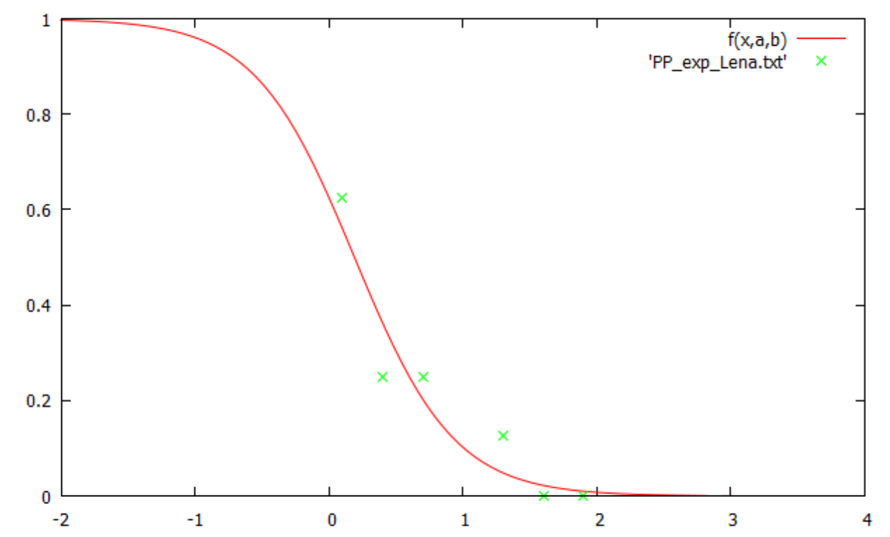
Result of Psychophysics Exp
These graphs show the pooled results of the discrimination
・X-axis shows the applied psf gain
・Y-axis shows the probability that subjects estimate
larger psf has better visibility
Result of character “A”
Result of Lena
2015.04.06 : Kohei Oshima
Notes:
This is result. These graphs show the pooled results of discrimination.
Left one is about Character “A”, and right one is about Lena image.
X-axis shows the applied psf gain like 0.1, 1.0, 1.9…
Y-axis shows the probability that subjects estimate larger psf compared with 1.0 has better visibility.
These green dots shows the average of probability. And red line is fitted these dots.
But these results are not good.

Slide 12
Result of Psychophysics Exp
These graphs show the pooled results of the discrimination
・X-axis shows the applied psf gain
The range from 0.25 to 0.75 is too large
Fitting line is shifted to the left
・Y-axis shows the probability that subjects estimate
larger psf has better visibility
Ideal result
Result of character “A”
Result of Lena
2015.04.06 : Kohei Oshima
Notes:
This is an ideal result.
This line shows the probability that subjects estimate larger psf has better visibility.
So if this 1.0 has best visibility, smaller value should takes high probability and larger value should take small probability.
About character “A”, the probability range from 0.25 to 0.75 is too large, it means we can’t distinguish sharpening images.
But it’s OK. Because our technique is to raise contrast, so it doesn’t have much effect for simple image.
About Lena image, fitting line is shifted to the left.
It means subjects prefer the image of lower sharpening degree than 1.0. It’s a problem.
Because of this problem, I couldn’t submit a paper for ISMAR.

Slide 13
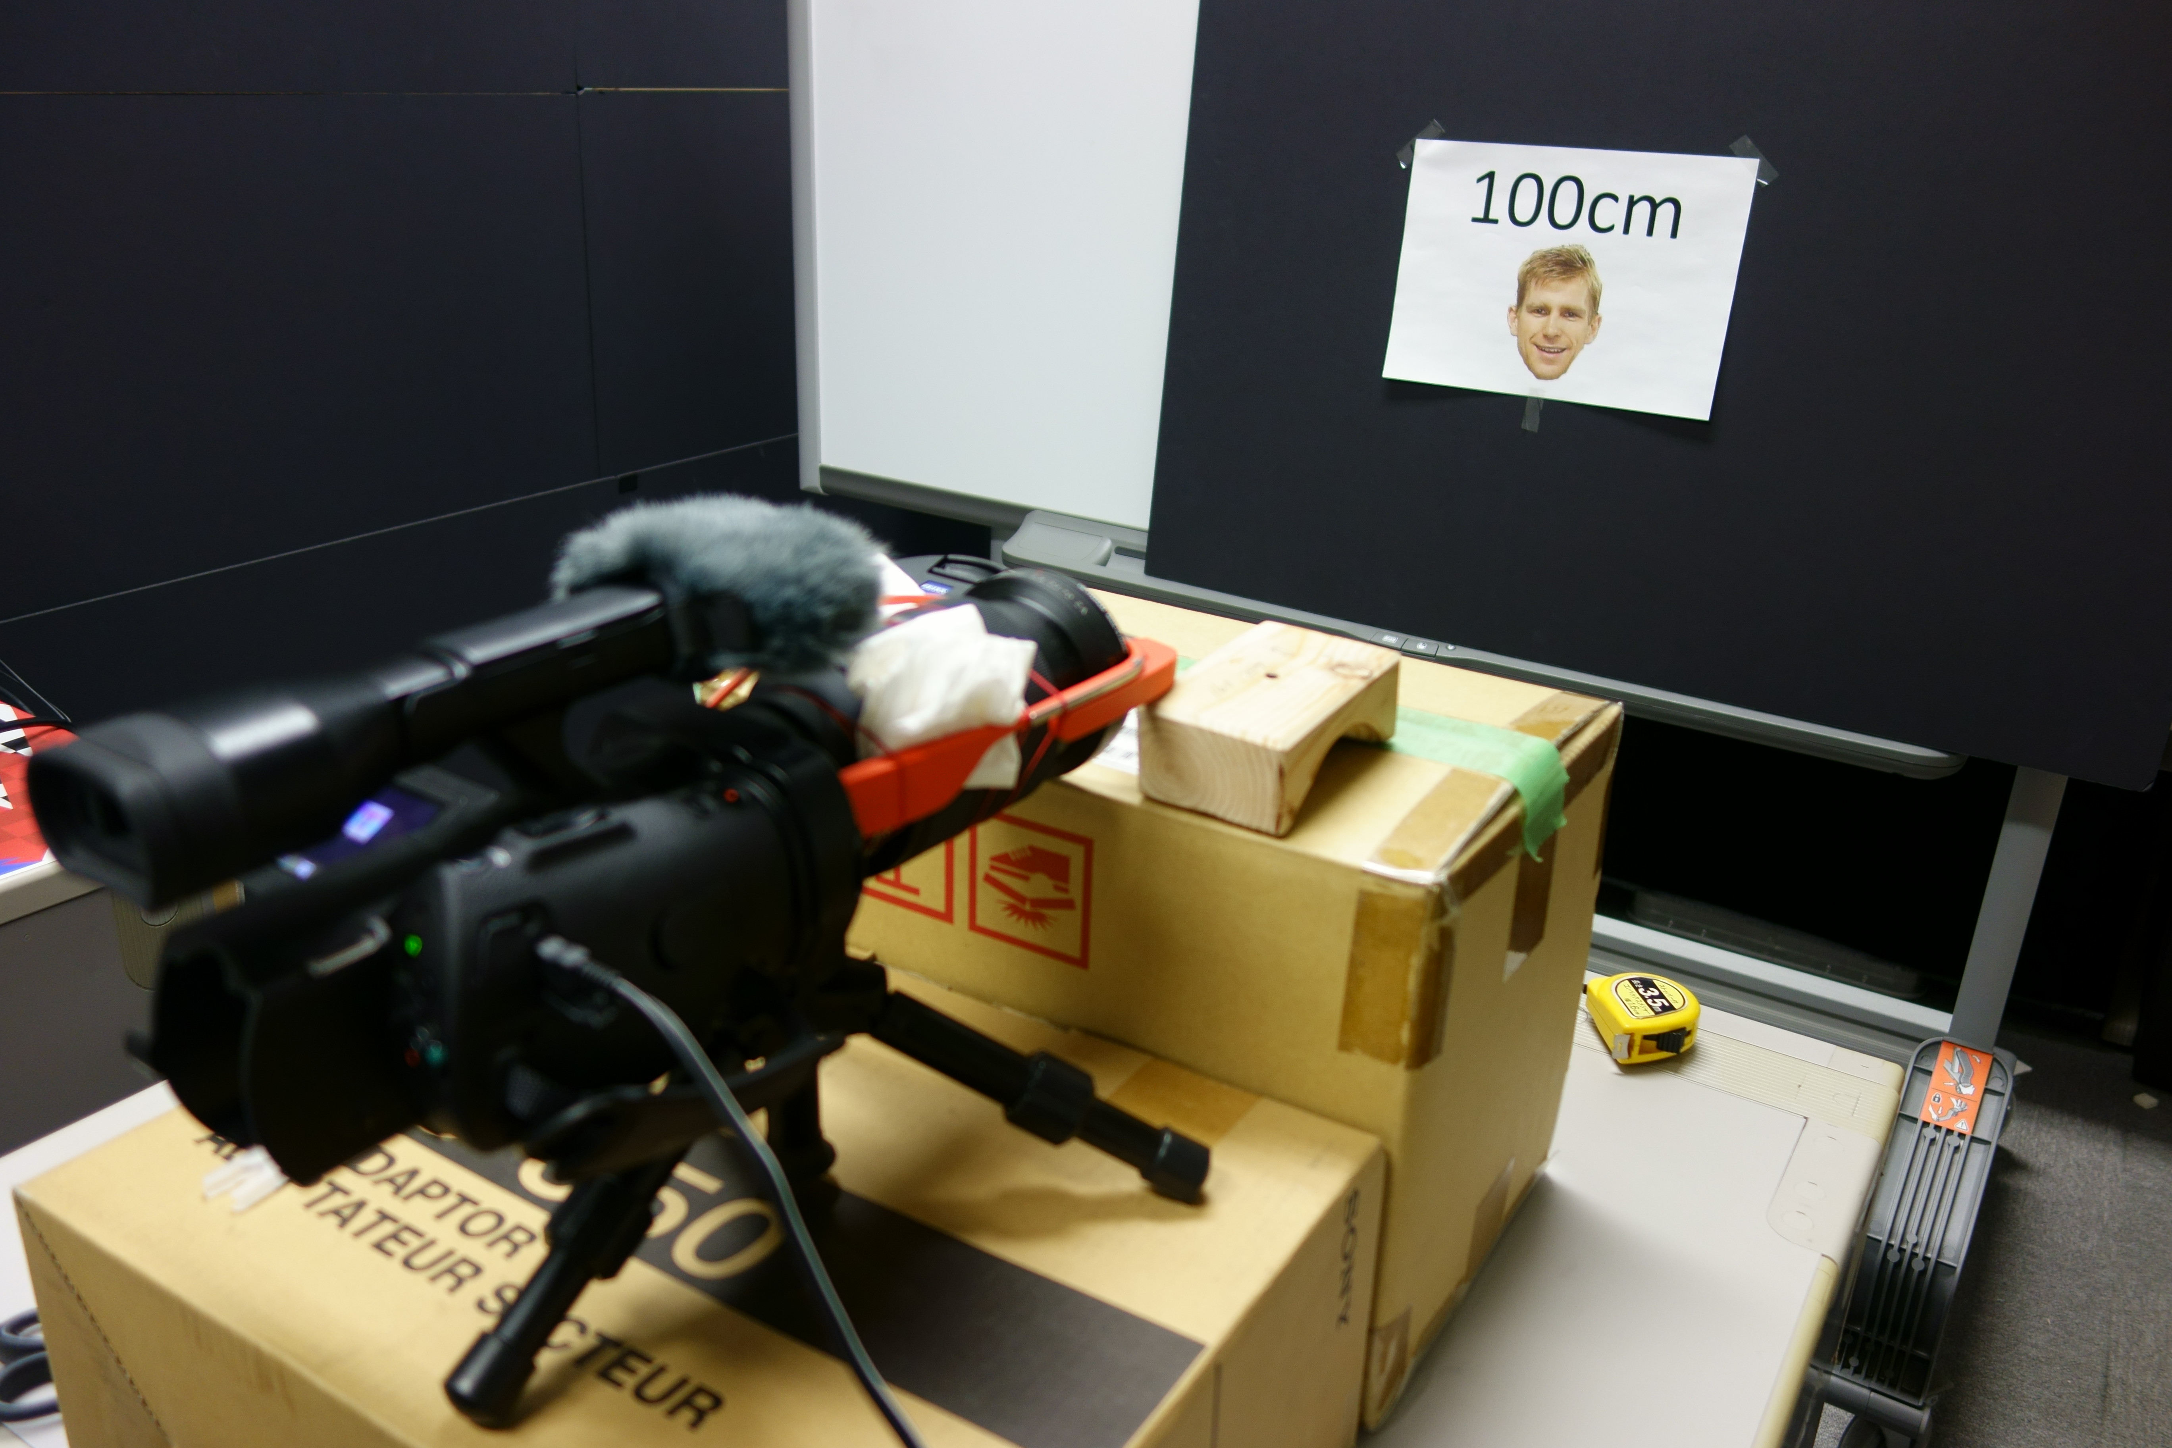
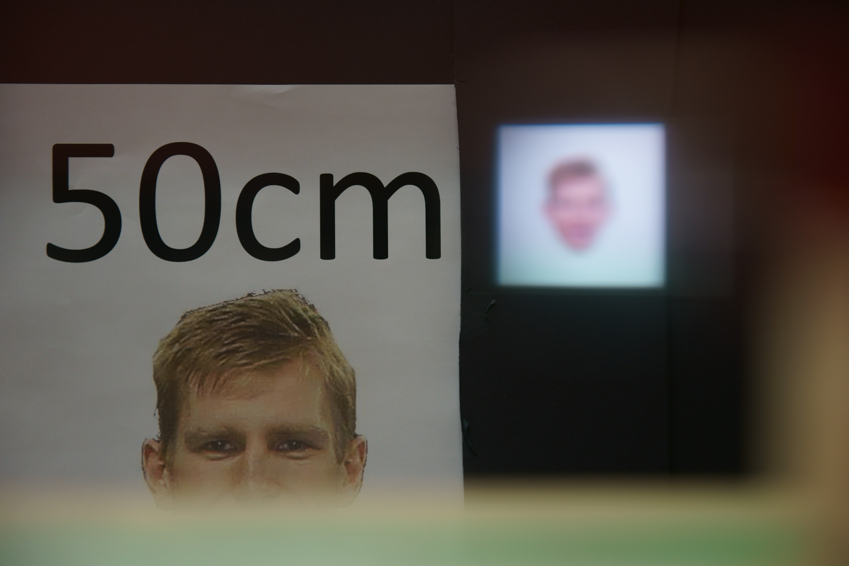
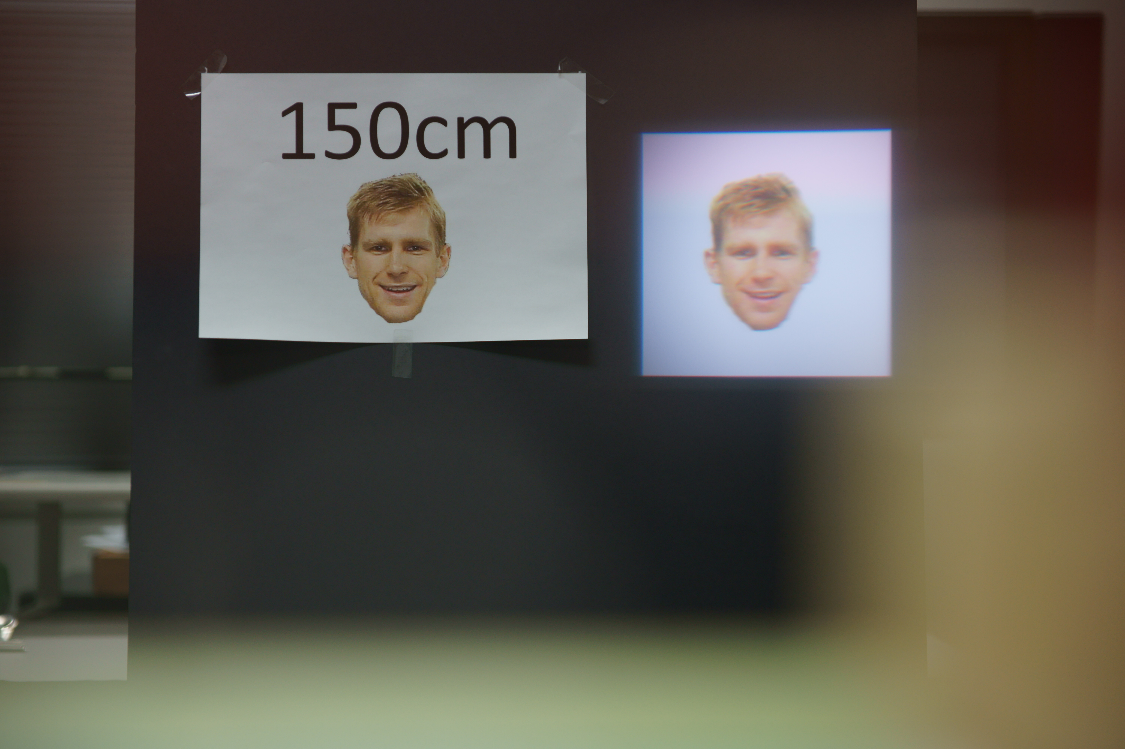
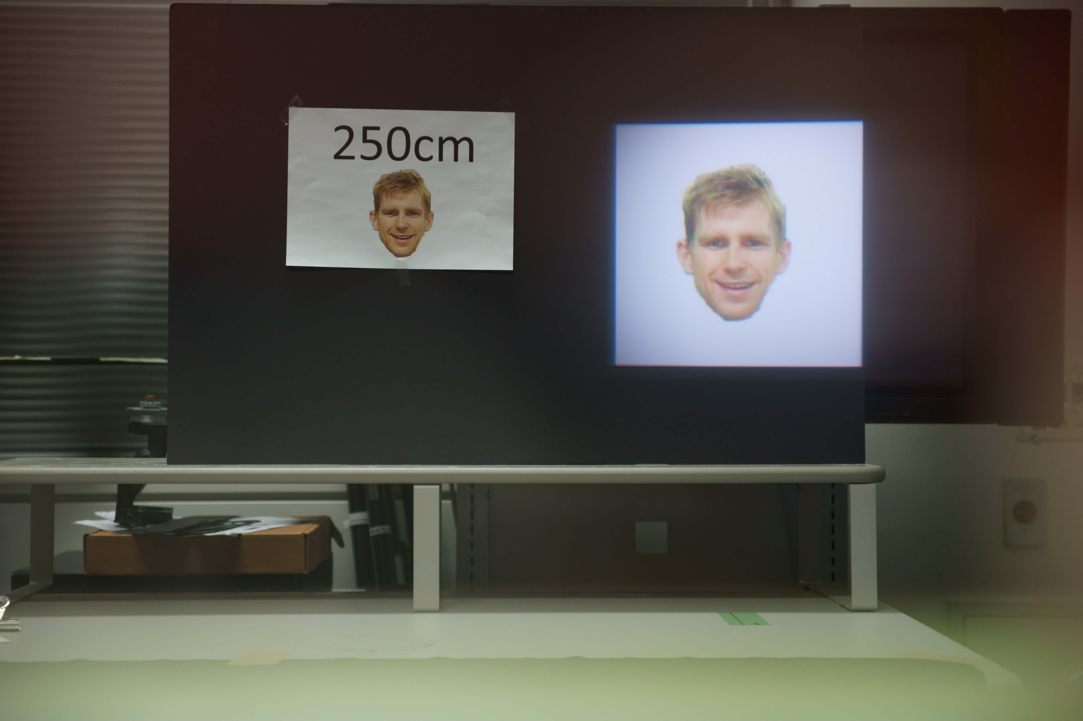
Discussion
The distance between the lens and virtual display?
・We approximated it as 70 cm
Shooting environment
u = 50cm
u = 150cm
u = 250cm
2015.04.06 : Kohei Oshima
Notes:
About discussion, I thought the cause of bad experiment result.
And I found a misunderstanding about the distance between the lens and virtual display, “u”.
I tried easy experiment, this is a shooting environment. I wore the google glass to the camera. And it focus on that plane.
This shows when camera focus on 50 cm depth, 150 cm depth, 250 cm depth.
It looks right one has the best visibility. So I found the distance between the lens and virtual display, “u” is not 70 cm.
Experiment condition was wrong. If you think other causes, please tell me.

Slide 14
Next Experiment
Verify Sharp View Equation
Does the current algorithm produce the optimal sharpening level?
Is there a perceptual threshold region (+/- some acceptable limit)?
Is the current “curve model” appropriate?
Verify Impact of Sharp View on Task Completion
Does Sharp View increase accuracy of perceptual task?
Does Sharp View decrease completion time of perceptual task?
Over what focal range does Sharp View afford the most utility?
2015.04.06 : Kohei Oshima
Notes:
About discussion, I thought the cause of bad experiment result.
And I found a misunderstanding about the distance between the lens and virtual display, “u”.
I tried easy experiment, this is a shooting environment. I wore the google glass to the camera. And it focus on that plane.
This shows when camera focus on 50 cm depth, 150 cm depth, 250 cm depth.
It looks right one has the best visibility. So I found the distance between the lens and virtual display, “u” is not 70 cm.
Experiment condition was wrong. If you think other causes, please tell me.

